Slide 1
Introduction to gis using qgis Part II
Daniela Spade | Instructor PhD Candidate | OU Department of Geography and Environmental Sustainability GIS Outreach Coordinator | Center for Spatial Analysis
dspade@ou.edu
Molly Simonis, PhD| Teaching Assistant OU Department of Biology

Slide 2
Goals for Tuesday
Add reference data to our maps
Learn how to join features in QGIS
Create printable maps in QGIS
Share resources for further learning

Slide 3
Adding basemaps (quickmap services plugin)

Slide 4
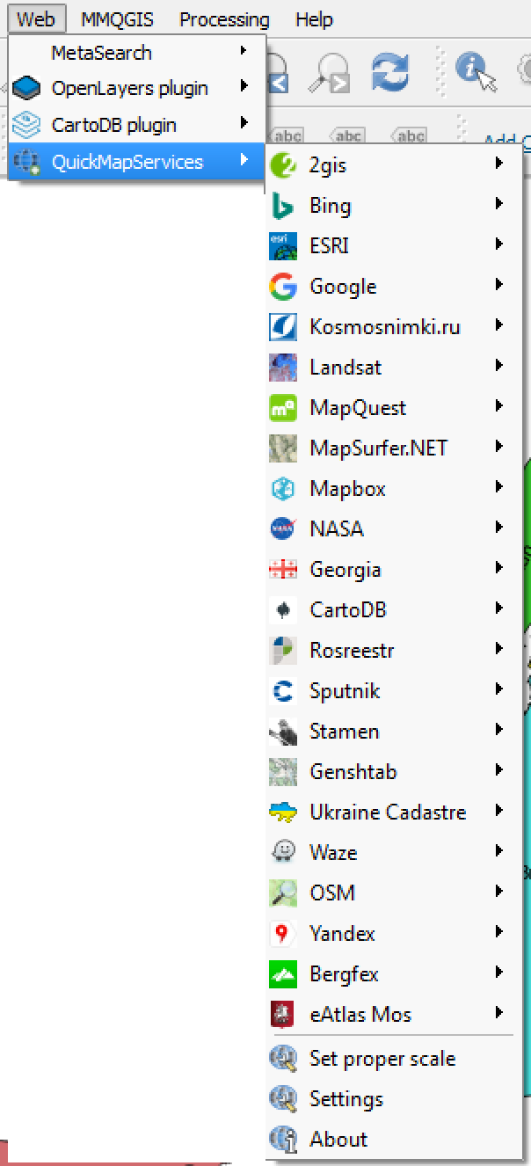
Adding basemaps (quickmap services plugin)
Choosing a Base Map
Think about what someone reading your map needs to see for context
Think about how the base map interacts with the data on your map

Slide 5
Base maps
If your data is the most important part of the map, make sure it looks more important than the base map
Avoid base maps that strongly emphasize features that aren't relevant on your map
Choose base maps with colors that complement your map's colors
The contrast between your map's colors and the base map's colors should be enough to make your layers clearly visible
Base maps show different levels of detail at different scales
Make sure the level of detail is appropriate to your map
Your Turn
• Find a good base map for your data
• Think about hierarchy, color, and scale
• Don't be afraid to play around

Slide 6
Basic spatial joins
Point to Polygon →Relate points inside a polygon to that polygon (ex. count the number of points)
Polygon to Point → Points can take on value of enclosing polygon
Exercise: Calculate the number of parking facilities by borough

Slide 7
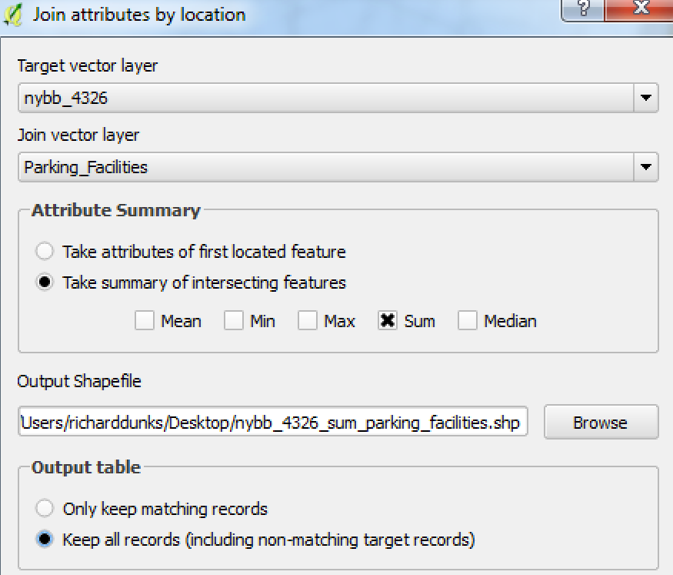
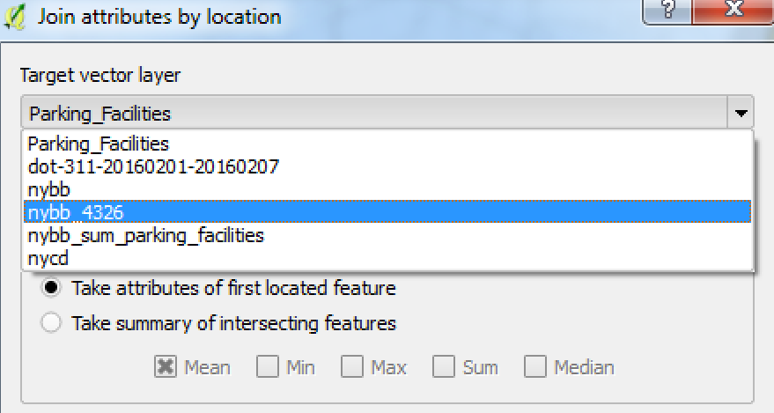
troubleshooting
Reproject Data
Redo Join

Slide 8
Your turn
Count the number of DOT 311 service requests in each community district in your borough
Style the community districts by the number of service requests

Slide 9
Print composer
How you make exportable and printable maps in QGIS
Able to add map elements (legends, scales, text, etc)
Creating a print composer
Select “New Print Composer”
Give it a title
Add elements to the blank canvas
Style elements

Slide 10
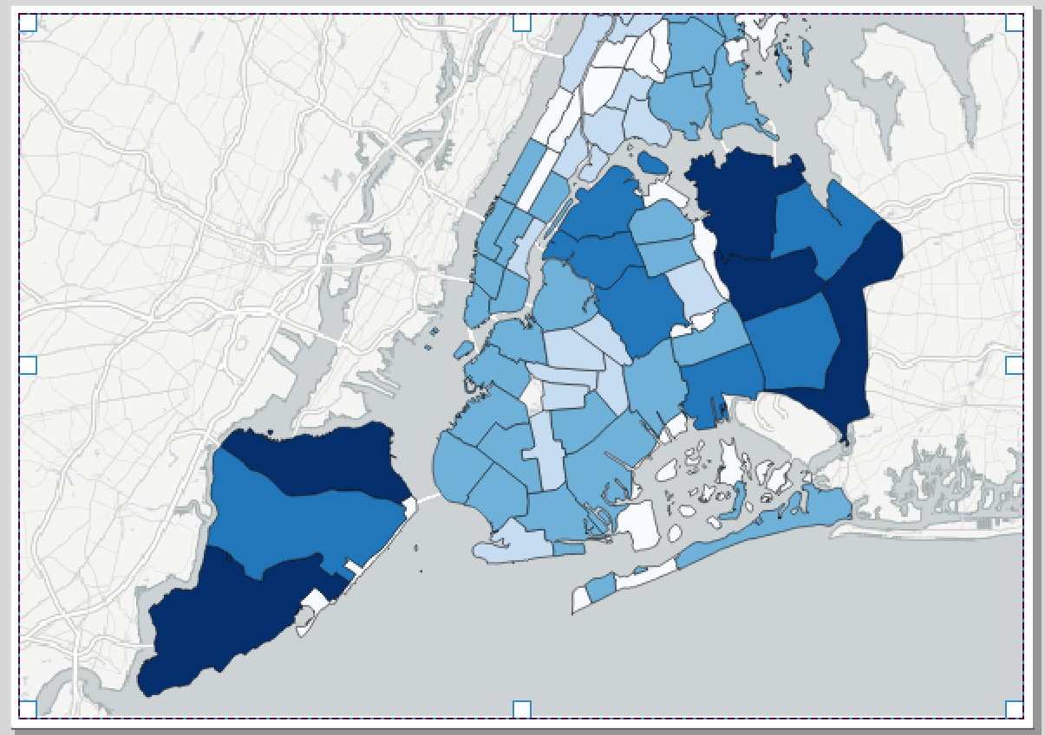
Print composer
Draw Map Extent

Slide 11
Print composer
Add Text to Map
Export Map
Customize Item Properties
Print Composer Troubleshooting
Map extent →"Use current map extent"
Moving map around → Adjust with arrows
North arrow → Manually align

Slide 12
Proprietary and open-source software
Proprietary software source code is owned by an individual or an organization and tightly restricted (usually for profit)
Open-source software source code is freely available to anyone for download, alteration, and republishing
Proprietary software code is generally supported by a team of paid professionals working for the organization that owns the code
Open-source software code is generally supported by a mix of paid and volunteer professionals that contribute changes back to the community
Proprietary software is often available only by purchasing a license
Open-source software is free to use though there generally a license that specifies the restrictions (if any) on its use and reuse
Companies using open-source software may charge for the use of the software through their proprietary implementations or via their infrastructure

Slide 13
Further learning
A few things we did not cover in this lesson:
Normalizing data for choropleths
Buffering features
Geocoding
Spatial databases
Other spatial data types (KML, GeoJSON, GeoTIFF)
Editing data

